Slide 1


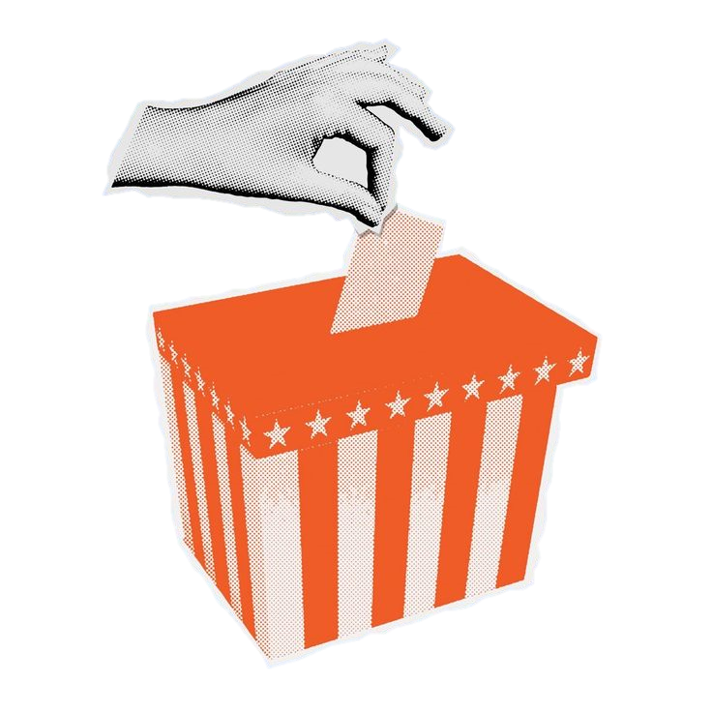
Votely A Secure, Transparent, and Accessible Voting System
Abinesh Haridoss Linh Doan
Renugopal Sivaprakasam Yi-Hsun Hsu

Slide 2

Problem Statement
Voting is the foundation of decision-making in any organization
Yet, many existing voting systems struggle with common issues:
lack of transparency,
difficulty verifying results,
limited accessibility,
challenges in scaling securely.

Slide 3
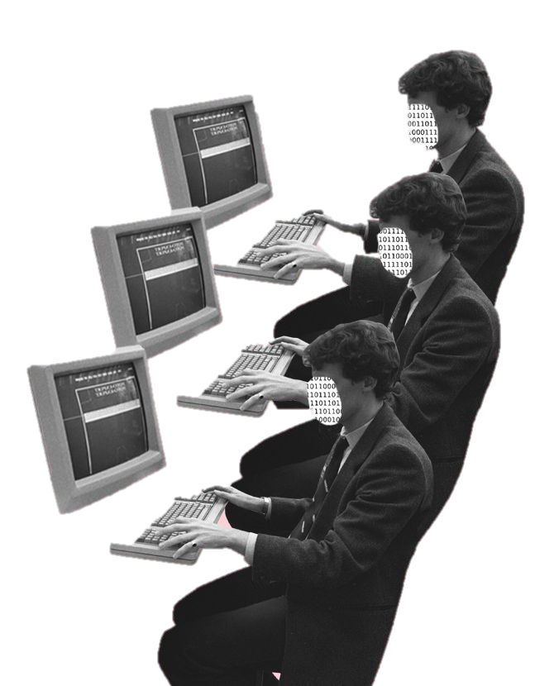

GradInnoHack Choices
Technology Cybersecurity / Blockchain
Impact Area Civic Tech / Government Transparency
User Group Any Organization / Government

Slide 4


Proposed Solution
Votely
Redefines the future of voting.
blockchain
1. Secure
2. Transparent
3. Accessible

Slide 5

Proposed Solution
User registration & eligibility validation
Vote casting via smart contract
Vote encryption
Vote tally and result display
Blockchain storage system
MVP
Scope

Slide 6
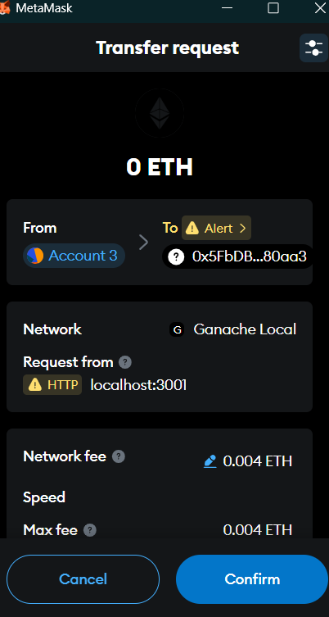
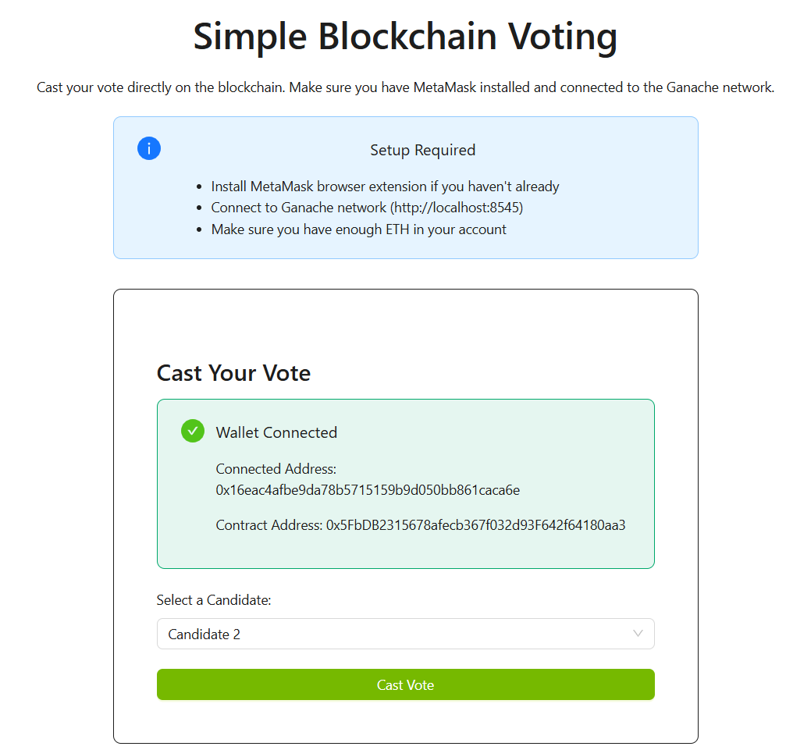
Demo

Slide 7

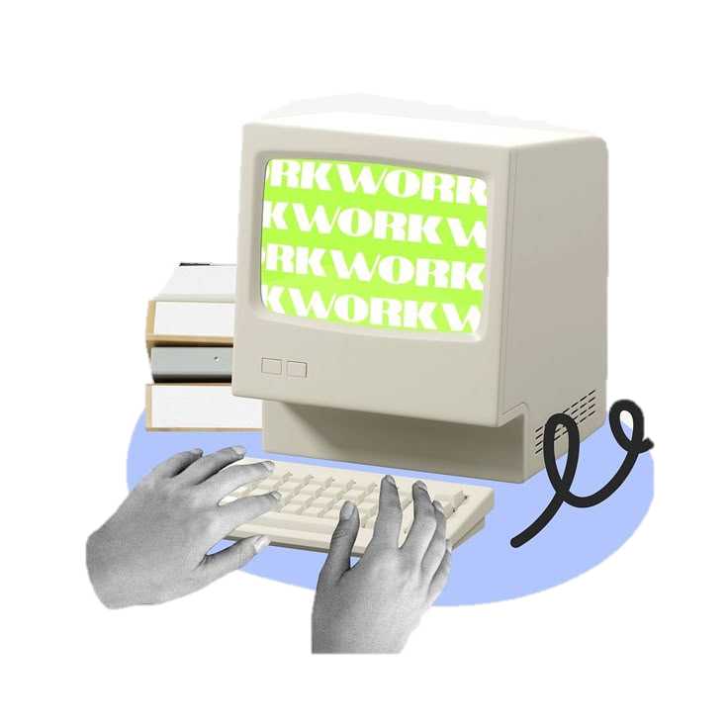

Proposed Solution
UNT
account
Apple account
Gmail account
SSN
Phone number
User
Votely Wallet
Voting
local governments
universities corporations
student councils

Slide 8







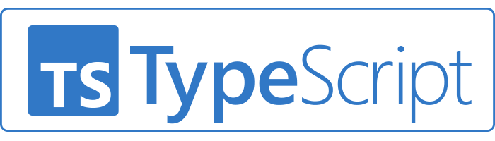
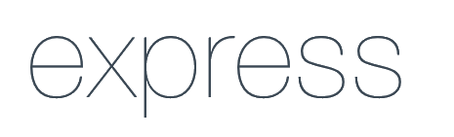

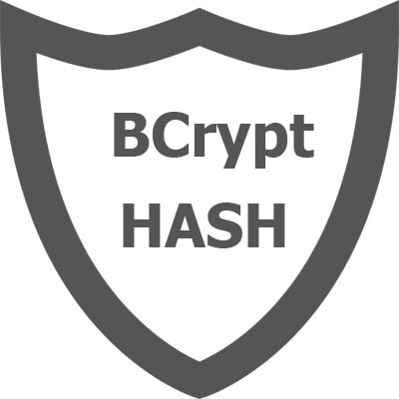
Proposed Solution
Technologies we used

Slide 9

Impact
Societal Benefits
Prevents fraud and tampering through blockchain’s transparency.
Builds public trust with verifiable, tamper-proof records.
Improves accessibility for all ages with remote and in-person digital voting.
Instant, transparent results via public blockchain ledger.

Slide 10


Unique Value Propositions
1
Transparency and real-time
2
Secure and confidential elections
3
High accessibility and availability
4
Consistency

Slide 11
THANK YOU
Abinesh Haridoss Linh Doan
Renugopal Sivaprakasam Yi-Hsun Hsu

